Slide 1

AWS DeepRacer Project
By: Avish Nagiana and Cole Dorman

Slide 2
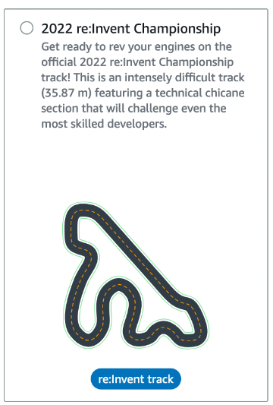

Introduction
Topics:
Steering Control
Speed Control
Track Alignment
Collision Avoidance
Handling Curvature
Conclusion

Slide 3
Steering Control
placeholder

Slide 4
Speed Control
placeholder

Slide 5
Track Alignment
placeholder

Slide 6
Collision Avoidance
placeholder

Slide 7
Handling Curvature
placeholder

Slide 8
Track Alignment
placeholder

Slide 9
The video
VIDEO HERE

